Slide 1
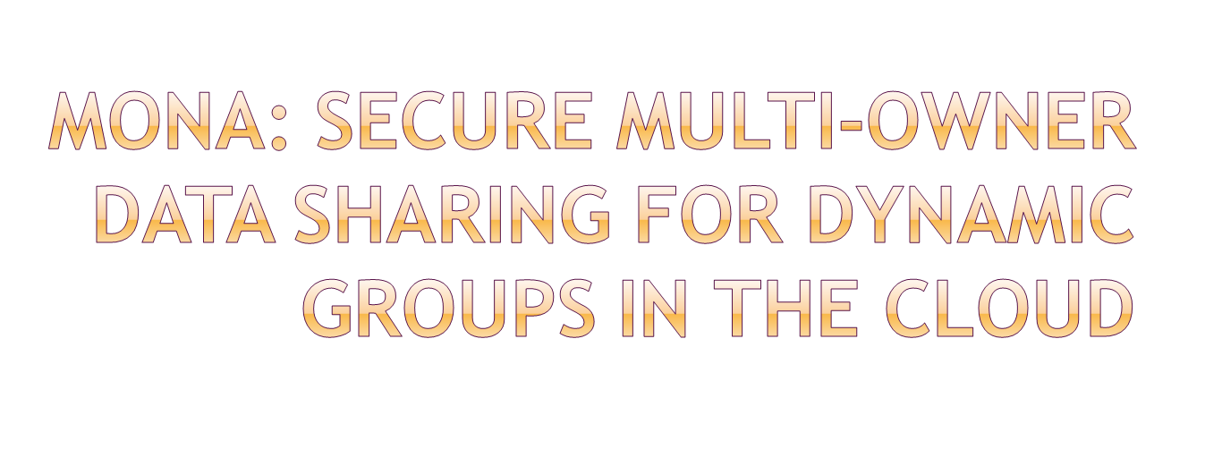

Slide 2
With the character of low maintenance, cloud computing provides an economical and efficient solution for sharing group resource among cloud users.
Unfortunately, sharing data in a multi-owner manner while preserving data and identity privacy from an untrusted cloud is still a challenging issue, due to the frequent change of the membership.
In this paper, we propose a secure multiowner data sharing scheme, named Mona, for dynamic groups in the cloud. By leveraging group signature and dynamic broadcast encryption techniques, any cloud user can anonymously share data with others.

Slide 3
Meanwhile, the storage overhead and encryption computation cost of our scheme are independent with the number of revoked users.
In addition, we analyze the security of our scheme with rigorous proofs, and demonstrate the efficiency of our scheme in experiments.

Slide 4

Many systems, though, do not even have the basic “attribute-value” annotation that would make a “pay-as-you-go” querying feasible. Existing work on query forms can beleveraged in creating the CADS adaptive query forms.The vast amount of data they have to deal with every day has made traditional database solutions prohibitively Expensive .
They propose an algorithm to extract a query form that represents most of the queries in the database using the ”querability” of the columns, while they extend their work discussing forms customization.

Slide 5

Privacy
Only the group manager can store and modify data in the cloud
The changes of membership make secure data sharing extremely difficult the issue of user revocation is not addressed
High expensive

Slide 6

The changes of membership make secure data sharing extremely difficult the issue of user revocation is not addressed
Our proposed scheme is able to support dynamic groups efficiently. Specifically, new granted users can directly decrypt data files uploaded before their participation without contacting with data owners. User revocation can be easily achieved through a novel revocation list without updating the secret keys of the remaining users. The size and computation overhead of encryption are constant and independent with the number of revoked users.
We provide rigorous security analysis, and perform extensive simulations to demonstrate the efficiency of our scheme in terms of storage and computation overhead.

Slide 7
Advantages:
Any user in the group can store and share data files with others by the cloud.
The encryption complexity and size of cipher texts are independent with the number of revoked users in the system.
User revocation can be achieved without updating the private keys of the remaining users.
A new user can directly decrypt the files stored in the cloud before his participation.

Slide 8

HARDWARE REQUIREMENTS:
System : Pentium IV 2.4 GHz.
Hard Disk : 40 GB.
Floppy Drive : 1.44 Mb.
Monitor : 15 VGA Colour.
Mouse : Logitech.
Ram : 512 MB.

Slide 9
SOFTWARE REQUIREMENTS:
Operating system : Windows 7 Professional.
Coding Language : Java
Database : Sql Server 2005.

